Slide 1


DIGITAL HEARING ASSISTANT
concept
process
project
team
use cases
requirements
GAMIFICATION & EDUCATIONAL CONCEPS
By Group 2

Slide 2

MAURICE CHRISNACH
MHAMMED AMINE DRIF
PARVEEN KUMAR APPARI
Team Communication & Coordination, Report Monitoring, Game & Educational Concepts
Research, Project Description, Target State
Research, Concept for Gamification & Education, SWOT Analysis, Report, Network Plan
concept
process
project
team
use cases
requirements
MAKARAND S. THORAT
SWARAJ RATH
VARSHA VENUGOPAL
MARIETTO SCHUSTER
Research, Project Planning, Risk Analysis summary & management plan
Chance & Risk Management, Analysis on KSF & CSF
Requirement Analysis,
MoSCoW Requirements, Use cases & Workflow model
Internal/External Stakeholder Analysis & Definitions, Influence and Measures

Slide 3


Duration & Location
Background
Objective
Develop an application supporting the use of cochlea implants
Boost the sales of cochlea implants
6 Months
At SRH Berlin
concept
process
project
use cases
team
requirements

Slide 4






01
INITIAL TEST
02
GAMING LEVELS
03
PLAY GAME
concept
process
04
project
team
requirements
VIDEO TUTORIAL
use cases
05
REWARD GALLERY
06
PROGRESS STATUS

Slide 5
01
INITIAL STATE
02
DEFINITION
CONCEPT
03
project
concept
process
team
requirements
use cases
REALIZATION & EXECUTION
04
TARGET STATE
05

Slide 6



Conduct Initial Test
Access Main Menu
Provide Tutorial/Level
Play Level
Take Initial Test
Play Stage 1-3
Monitor Progress
Initial Analyzation
View Tutorial
Give Stage Rewards
Record/Give Feedback
Prepare Level
View Reward Gallery
Update Progress
project
concept
process
team
requirements
use cases
Doctor
User
Database

Slide 7
concept
project
process
team
use cases
requirements
MUST HAVE
SHOULD HAVE
COULD HAVE
NICE TO HAVE
Games of varying range
New Game Levels
Mascot presence
Mascot encouragement
Main Menu access
Easy Initial Test
Video Tutorial
Liberty to view Gallery
Incentives
Progress Update
Feedback System
Weekly Follow-up Sessions
Automating evaluation process
Doctors/Therapists/ Teacher/Parents encouragement

Slide 8

Teacher
Therapist
Product Owner
Parents
concept
project
process
team
use cases
Internal
External
stakeholders
Development Team
Users
Implant Manufacturer
Other potential Users

Slide 9
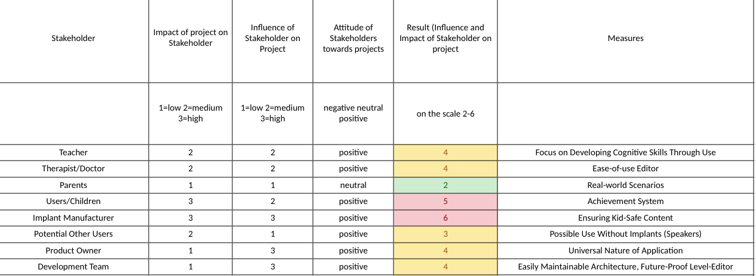
concept
project
process
team
use cases
stakeholders

Slide 10
Concept Background
Progress
Motivation
Knowledge
Training
Game-based learning
Gamification
Education
concept
project
process
team
use cases
requirements
Rewards
Skills
Notes:
Gamebased learning is a combination between gamification and education
Gamification: Use of game design elements in a non-game context
Why: Progress, Motivation and Rewards
Education? Leaning something
WHY? Learn to get knowledge, train to perfect skills
Why is it so important for the Digital Hearing Assistant?
Motivation for the child, Playful manner , digital reward
Nowadays more and more digital applications for kids
Digital Progress Monitoring

Slide 11
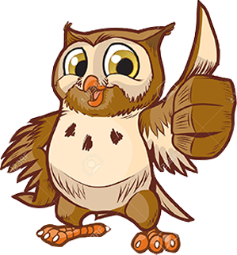
Concept Overview
Hi, my name is Owly!
Stage 0
Initiation Test
Stage 1
Exploring Sounds
Stage 2
Sound Quiz
Stage 3
Finding Sounds
Elements
Scenes
concept
project
process
team
use cases
requirements
Prepared Level
Reward Gallery
Sounds
Notes:
Go over all the section
Introduce the mascot
Say why its different from the UX/UI group

Slide 12


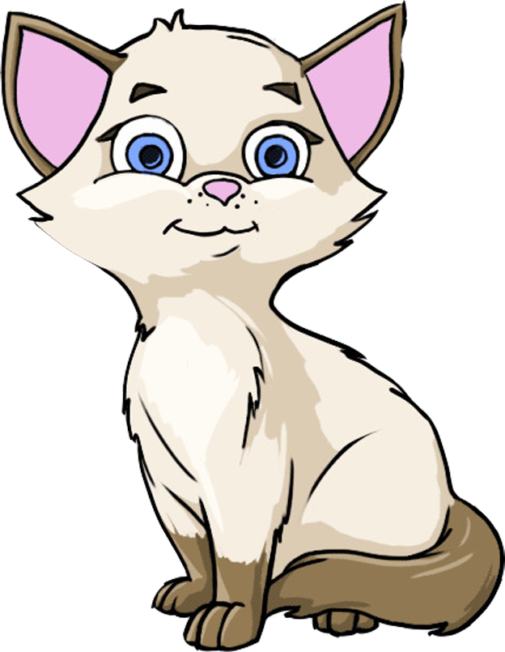

Elements
concept
project
process
team
use cases
requirements
Cut-out Pictures of Objects, Animals or Humans
Can be put in the Scene
Have a specific sound
Notes:
1 Component for the concept: Elements
What can you see on the screen
What are Elements?
What can be done with elements

Slide 13
Concept Overview
Stage 0
Initiation Test
Stage 1
Exploring Sounds
Stage 2
Sound Quiz
Stage 3
Finding Sounds
Elements
Scenes
concept
project
process
team
use cases
requirements
Prepared Level
Reward Gallery
Sounds
Notes:
Next Scenes

Slide 14
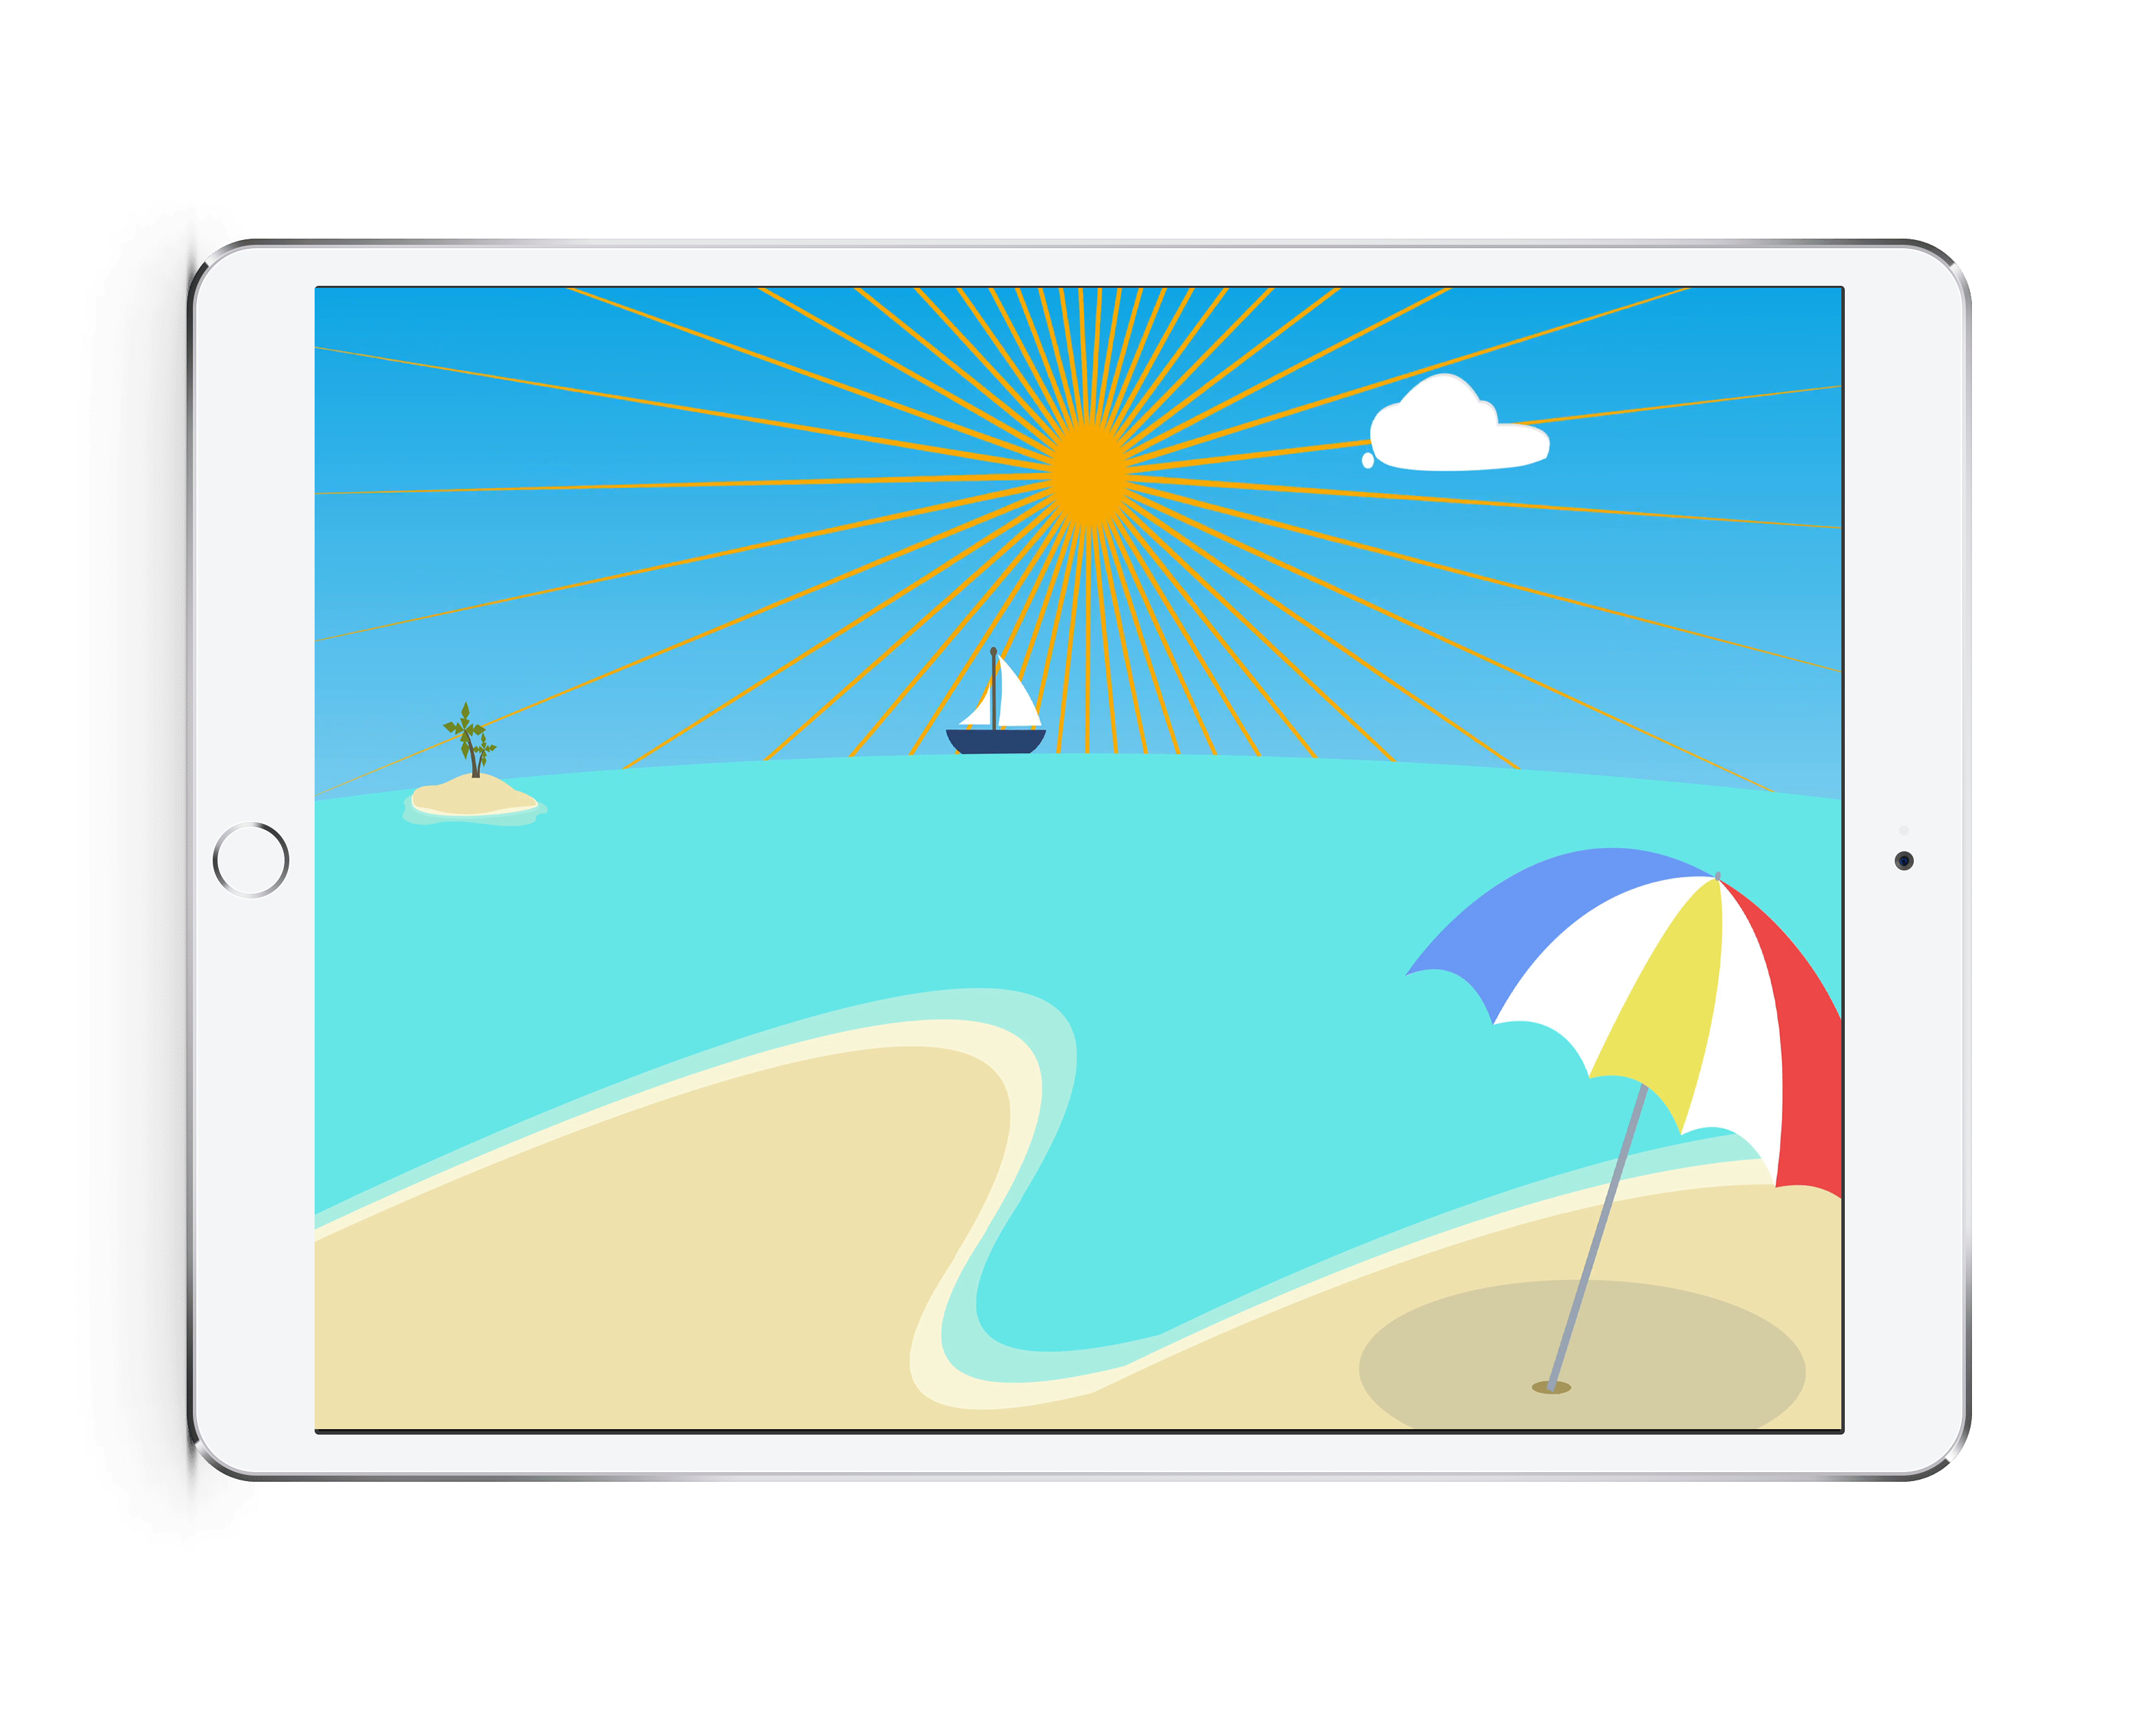
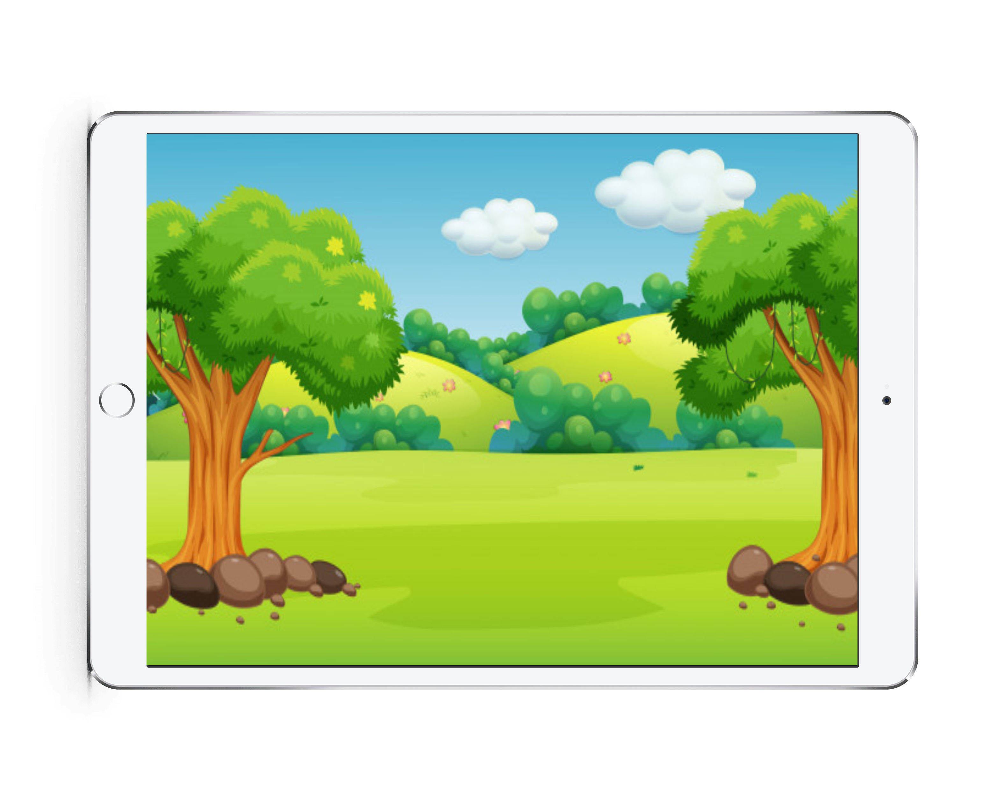


Scenes
concept
project
process
team
use cases
requirements
Different Backgrounds to put Elements on
Scenes can have Background noise
Notes:
2 Component for the concept: Scenes
What can you see on the screen
What are scenes
What can be done with elements
Discuss, why Background Noise, why not?

Slide 15
Concept Overview
Stage 0
Initiation Test
Stage 1
Exploring Sounds
Stage 2
Sound Quiz
Stage 3
Finding Sounds
Elements
Scenes
concept
project
process
team
use cases
requirements
Prepared Level
Reward Gallery
Sounds
Notes:
Next Sound

Slide 16
MIAU!
Sounds
concept
project
process
team
use cases
requirements
Sounds always have a matching element
Elements can have multiple sounds varying in pitch or volume
Wuuuusch
Notes:
3rd Component for the concept: Sounds
What can you see on the screen
Properties of sound
1 element more sounds

Slide 17
Concept Overview
Stage 0
Initiation Test
Stage 1
Exploring Sounds
Stage 2
Sound Quiz
Stage 3
Finding Sounds
Elements
Scenes
concept
project
process
team
use cases
requirements
Prepared Level
Reward Gallery
Sounds
Concerned Stakeholders
RISK
Risk Elimination Symbol
Doctor
Child
Notes:
Explain Risk and Stakeholder
Next: Stage 0

Slide 18
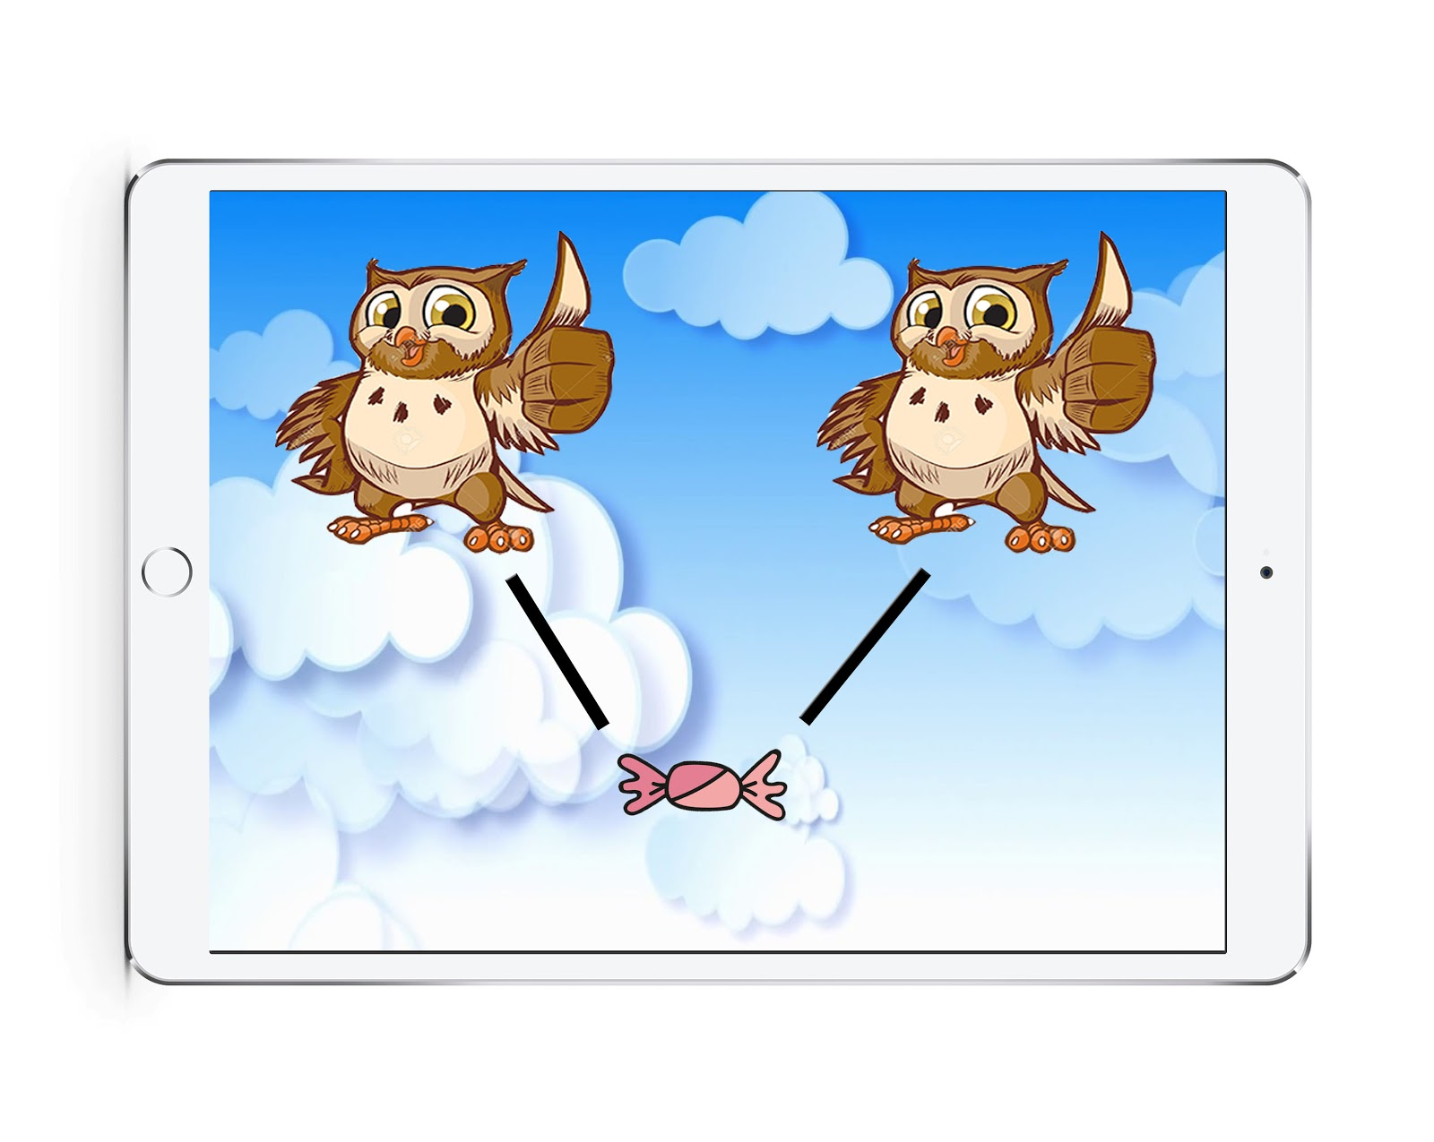
Stage 0
Initiation Test
concept
project
process
team
use cases
requirements
Optional/Pre-set Stage
Based on “Play audiometry
Test current level of hearing ability
Concerned Stakeholders
RISK
Child not understanding the application’s sound
Doctor
Child
Notes:
-Explain the initial test
-Say that it is a pre-set stage
-Based on the Play audiometry Hearing test:
child is rewarded upon the completion of a specific task related to the audio played
-Why?
-Stakeholders
-Risk elemination

Slide 19
Concept Overview
Stage 0
Initiation Test
Stage 1
Exploring Sounds
Stage 2
Sound Quiz
Stage 3
Finding Sounds
Elements
Scenes
concept
project
process
team
use cases
requirements
Prepared Level
Reward Gallery
Sounds
Concerned Stakeholders
Doctor
Child
Notes:
Next Stage 01

Slide 20
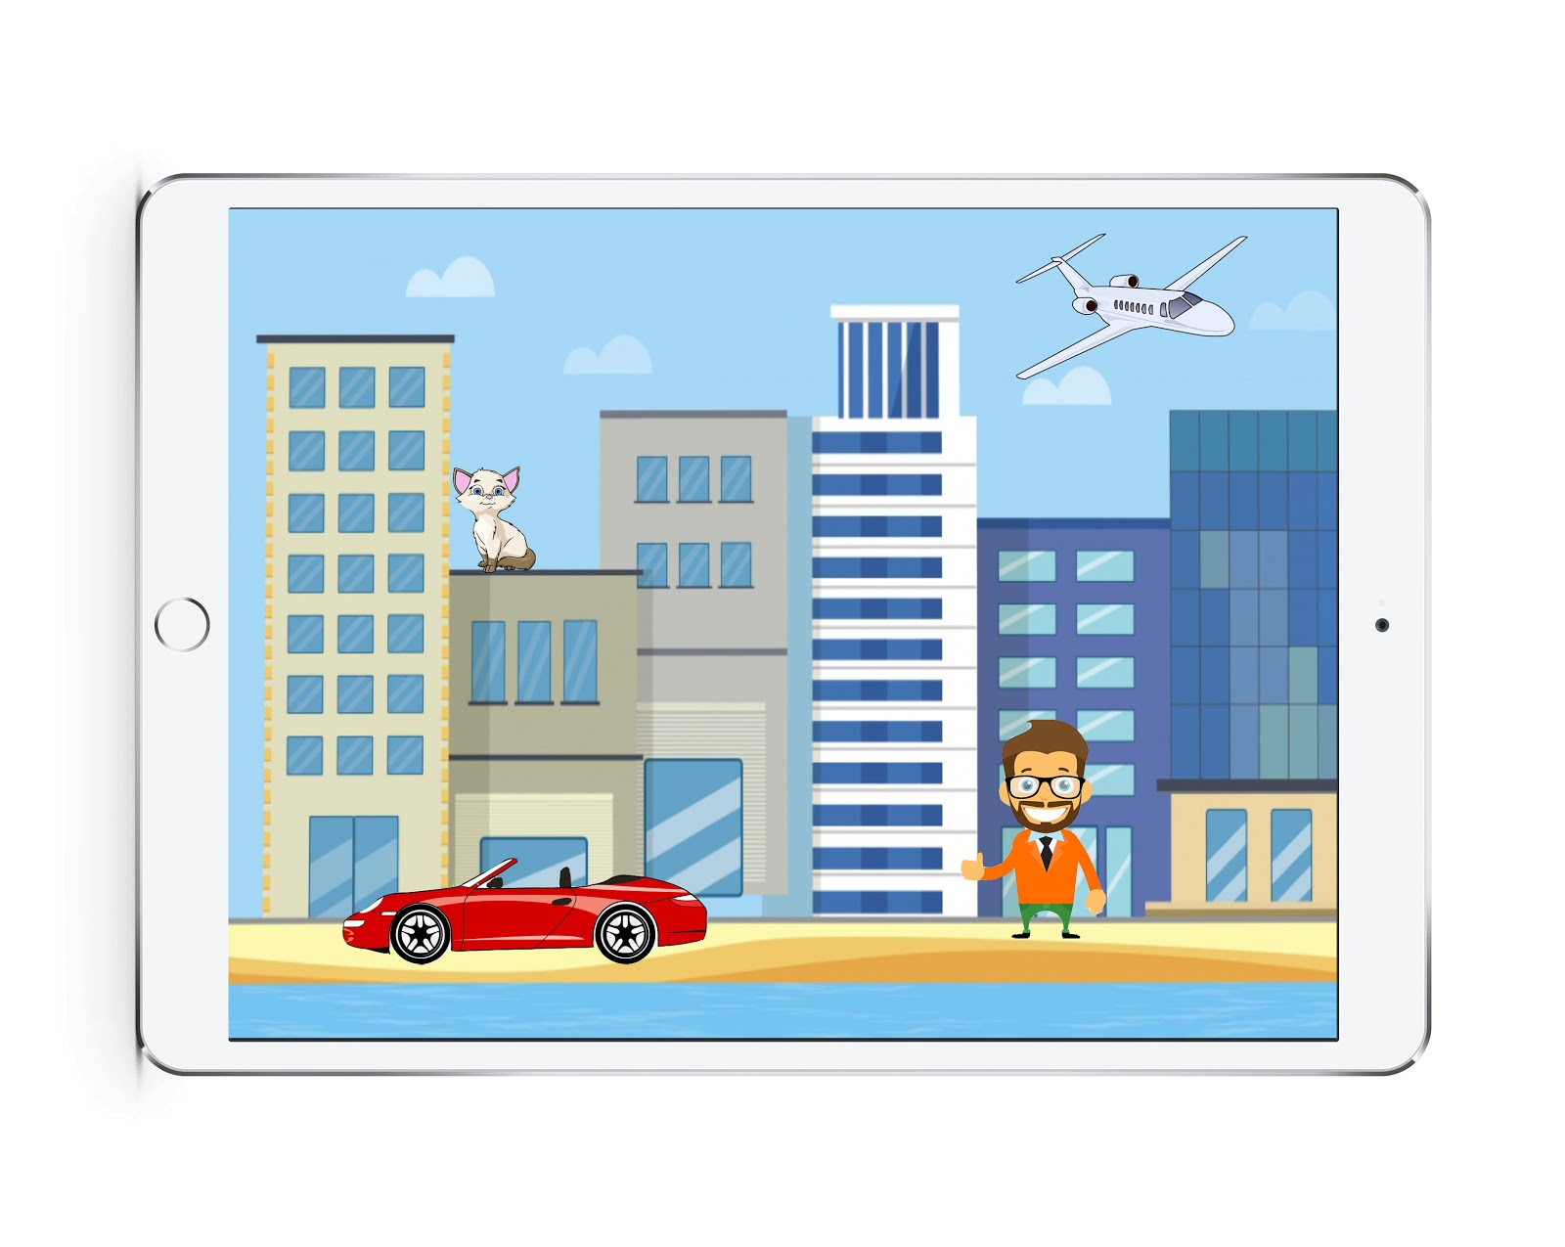
Stage 1
Exploring Sounds
I show you the elements you missed!
concept
project
process
team
use cases
requirements
Elements in a Scene with Sounds
Touch each element at least once
Exploring phase
Concerned Stakeholders
RISK
Game too difficult
Doctor
Child

Slide 21
Concept Overview
Stage 0
Initiation Test
Stage 1
Exploring Sounds
Stage 2
Sound Quiz
Stage 3
Finding Sounds
Elements
Scenes
concept
project
process
team
use cases
requirements
Prepared Level
Reward Gallery
Sounds
Concerned Stakeholders
Doctor
Child
Notes:
Next Stage 02

Slide 22
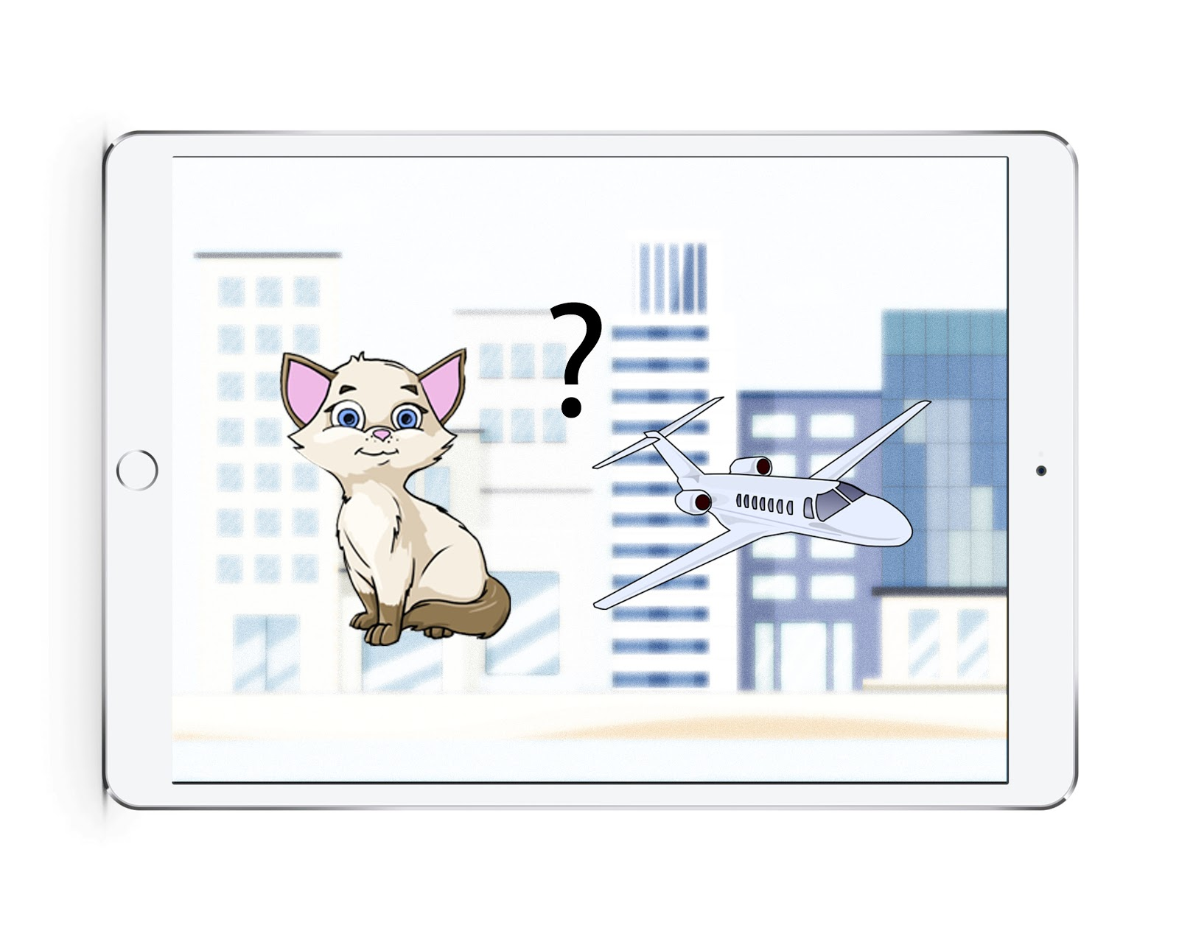
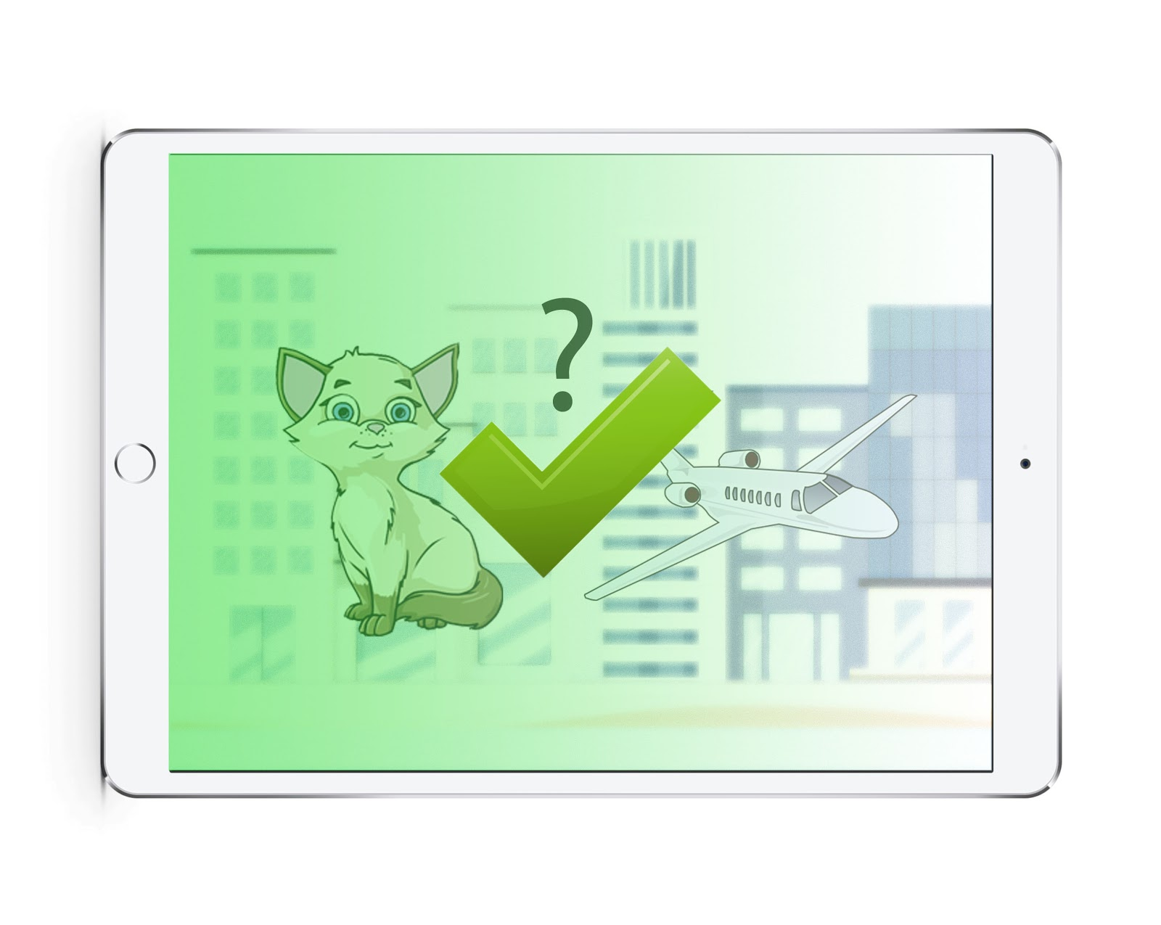
Concerned Stakeholders
Stage 2
Sound Quiz
Doctor
Child
I point to all the different options!
concept
project
process
team
use cases
requirements
Use all Elements of Stage 1 to create a Quiz
Ask each element at least once
I am happy that you guessed correctly!
Notes:
Explain stage 2
Mascot

Slide 23
Concept Overview
Stage 0
Initiation Test
Stage 1
Exploring Sounds
Stage 2
Sound Quiz
Stage 3
Finding Sounds
Elements
Scenes
concept
project
process
team
use cases
requirements
Prepared Level
Reward Gallery
Sounds
Concerned Stakeholders
Doctor
Child
Notes:
Next stage 3

Slide 24
Stage 3
Finding Sounds
I point to all the different options!
!
concept
project
process
team
use cases
requirements
Hear a Sound and find the corresponding Element
Ask each Sound at least once
Concerned Stakeholders
Doctor
Child
Notes:
Explain stage 3
Mascot job

Slide 25
Concept Overview
Stage 0
Initiation Test
Stage 1
Exploring Sounds
Stage 2
Sound Quiz
Stage 3
Finding Sounds
Elements
Scenes
concept
project
process
team
use cases
requirements
Prepared Level
Reward Gallery
Sounds
Concerned Stakeholders
Doctor
Child
Notes:
Next Gallery

Slide 26
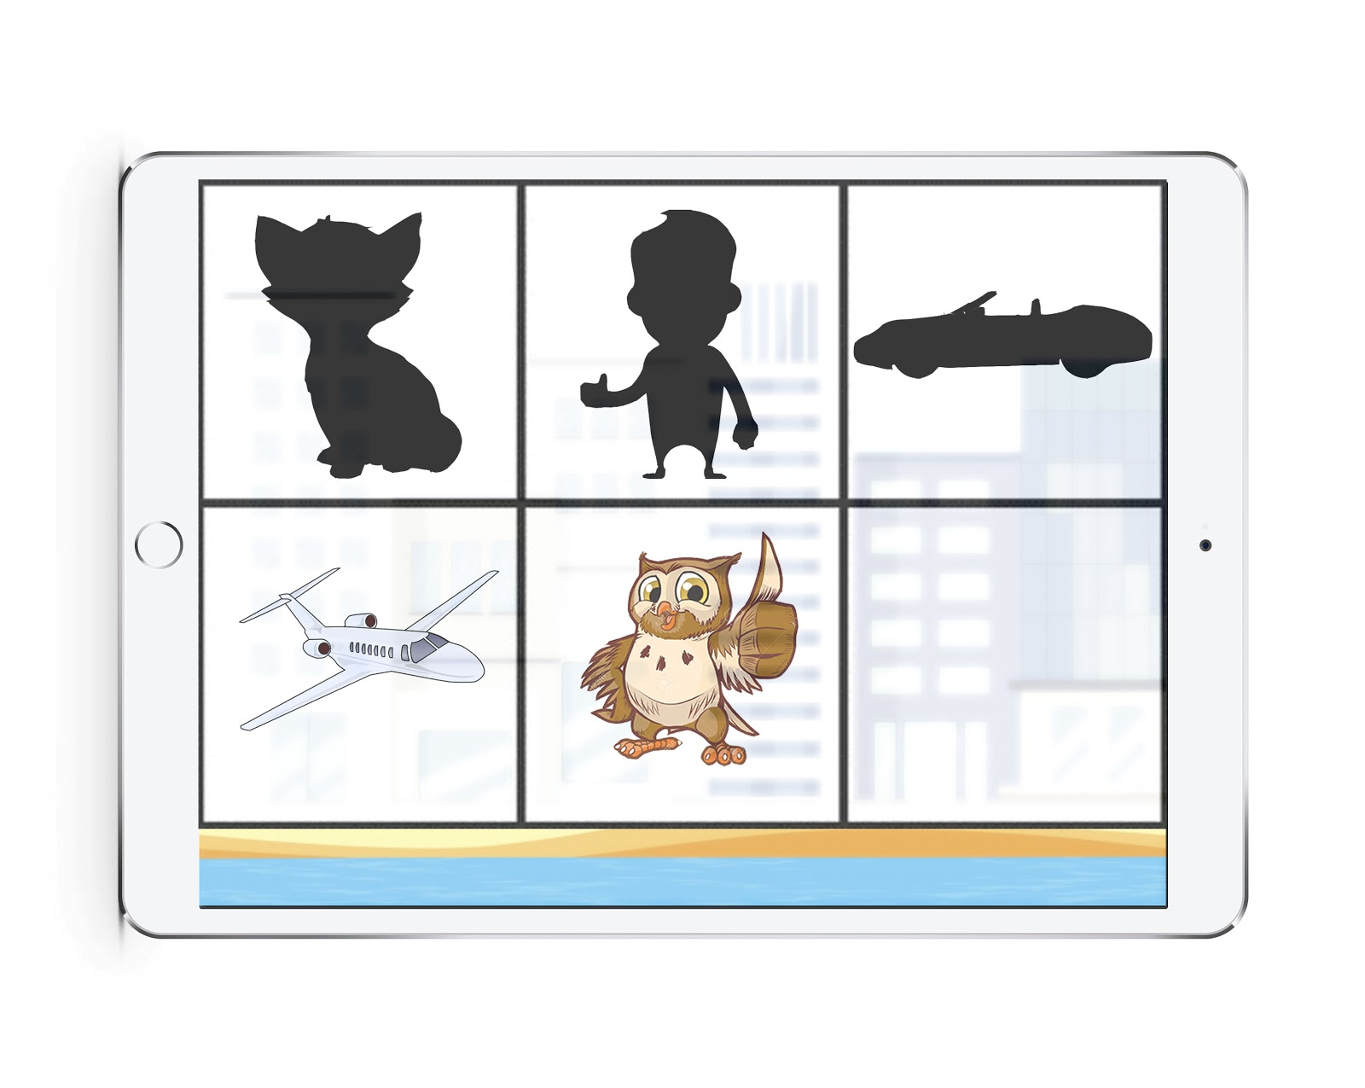
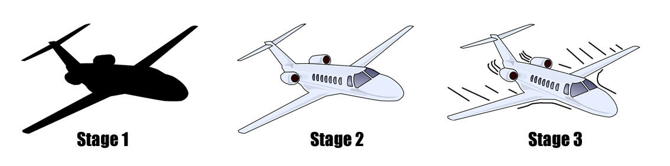
Concerned Stakeholders
Reward Gallery
Doctor
Child
concept
project
process
team
use cases
requirements
Each Element recognized in the Stage gives a Reward for the Gallery
Gallery can be visited at any time
RISK
Child not motivated
Notes:
Reward system explain
Stakeholders
Risk

Slide 27
Concept Overview
Stage 0
Initiation Test
Stage 1
Exploring Sounds
Stage 2
Sound Quiz
Stage 3
Finding Sounds
Elements
Scenes
concept
project
process
team
use cases
requirements
Editor
Reward Gallery
Sounds
Concerned Stakeholders
Doctor
Child
Notes:
Next Editor

Slide 28
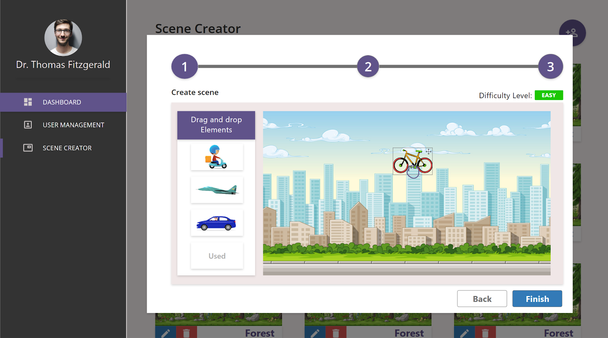
Editor
summary
concept
project
process
team
use cases
requirements
Build individual levels
Use elements, scenes and sounds
Set difficulty for the different Stages
Concerned Stakeholders
RISK
Repetitive Levels & no increase in difficulty
Doctor
Child
Notes:
Explain Editor
Stzakeholder
Rsk elimination

Slide 29
Questions or Remarks?
concept
project
Q & A
process
team
use cases
requirements

Slide 30
Thank you for your attention!
Q & A
project
concept
process
team
use cases
requirements

